Slide 1
Cyclistic Riders Tendencies: Member vs Casual
Presented by: Christopher Mancuso
Last Updated: January 19th, 2023
Notes:
Title, as presented by me, with slides and data last updated on date.

Slide 2
Cyclistic Rider Tendencies
Table of Contents
Background Information (Who is Cyclistic?)
Purpose Statement (What are we talking about?)
The Story (With Data)
Conclusion (With Recommendations)
Appendix
Notes:
Give you an idea of what to expect. Table of contents, 4 main areas of this presentation. 0th, who is Cyclistic, and how do the operate? This is only for presentations outside of the company. 1st, what questions(business task) are we trying to answer with our data(ask the question). 2nd, presenting the data to back up our hypothesis(answer the question). 3rd, presenting possible solutions to the business task that take into account our data(resolve the question).

Slide 3
Who is Cyclistic?
Notes:
Cyclistic is a convenient, fun, and affordable transportation option for commuting to work, getting around town, and exploring Chicago. Like other bike-share systems, Cyclistic consists of a fleet of specially designed, geotracked, and durable bikes that are locked into a network of docking stations throughout the region. The bikes can be unlocked from one station and returned to any other station in the system 24/7.

Slide 4
Cyclistic Business Model
Single-ride passes for $3 per 30-minute trip
Full day passes for $15 per day for unlimited three hours rides in a 24 hour period
Annual memberships for $99 per year for unlimited 45 minute rides
$0.15 per minute charge when single rides exceed the maximum time allowance
Notes:
Cyclistic consists of these pass types to support its business model. Anything that isn’t the annual membership is considered a casual rider.

Slide 5
Purpose Statement
Notes:
Q: What are we talking about? A: We are talking about answering our business task: Our overarching goal is to convert casual riders to members. To do this, we need to know -> How do annual members and casual riders use Cyclistic bikes differently? And act on the insights we found.

Slide 6
Objective
Identify the differences in how our annual members and casual riders use Cyclistic bikes to support our marketing push to increase membership
Notes:
Identify how our annual members use Cyclistic bikes, how our casual riders use Cyclistic bikes, and how they differ (trip duration) and (number of trips)

Slide 7
The Data
Notes:
Data is from the 2022 calendar year, and is separated by months. Data was cleaned by me. We’re focusing primarily on two categories, trip durations, and trip totals, organized by casual or member.

Slide 8
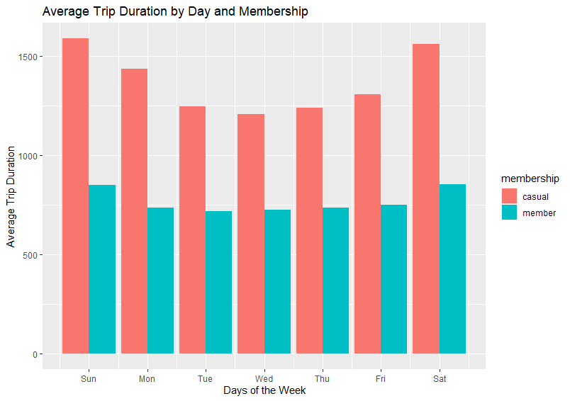
Average Trip Durations
Casual riders ride for longer durations on average
Members are more likely to ride for shorter durations
Notes:
Looking at the chart, we can clearly see that casual riders are more likely to ride for longer durations than members. They push near the bounds of the $3 30 minute pass. Possible explanations include attempting to be as cost effective as possible, as repeated bike check outs can quickly rack up for the casual riders. ($15 for 3 hours and unlimited rides within 24 hours, vs $3 for 30 - $15 on the 30 minute pass equals 2.5 hours of ride time) Members have the luxury of unlimited check outs, so they are more likely to check out a bike for a short trip.

Slide 9
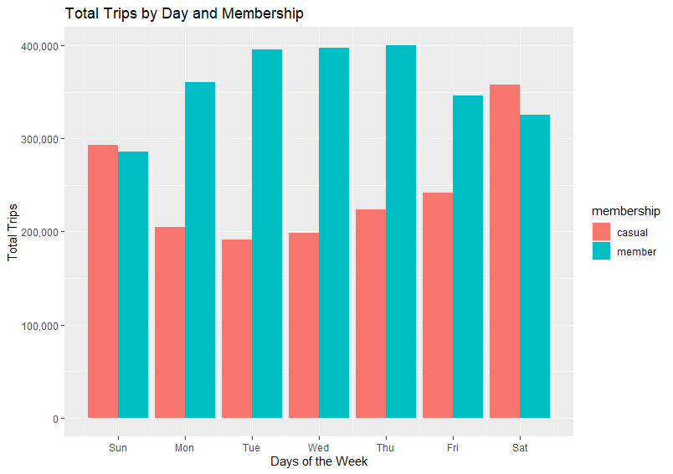
Total Daily Trips by Membership
Casual riders are most active during the weekend
Members are most active during the week
Members take more trips than casual riders
Notes:
Casual vs member by days of the week. Casuals take more trips during the weekend, while members take more trips during the week. Members also take more trips in general, only losing on the weekends. Casual riders drop significantly during the week. Again, casual riders probably drop trip frequency due to cost, as weekdays tend to have less time for uninterrupted riding. Reduced effectiveness of 24 hour pass vs 30 minute pass vs membership.

Slide 10
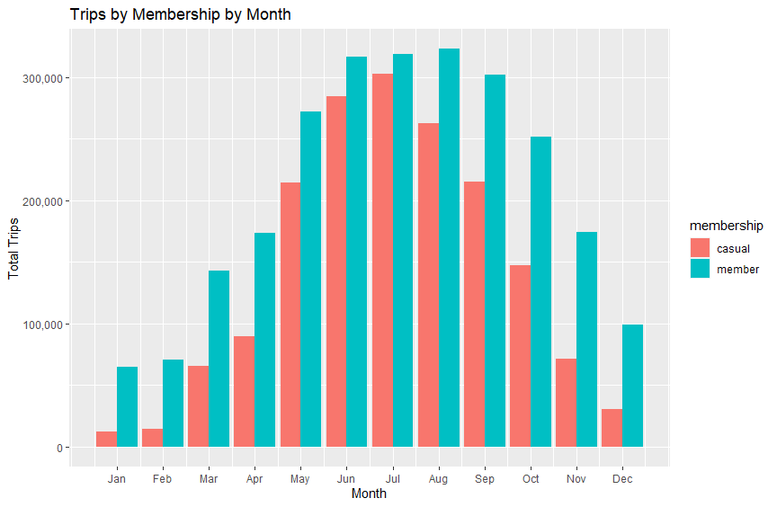
Total Monthly Trips by Membership
Casual riders are most active during warmer months
Members are most active during warmer months
Notes:
More casual riders are using the service during warm weather months. This is the same for members, though members are more likely to use the service in cold months than casual riders.

Slide 11
Conclusions
Notes:
Based on the data, we can make a few conclusions and helpful suggestions for how Cyclistic should approach solving the business problem. 1st, casual riders take fewer but longer trips, and favor weekends and warm months, compared to members who take more frequent but shorter trips, and favor weekdays. 2nd, casual riders may be put off by the high membership cost; their average ride time is 26 minutes, which is very close to the $3 pass time limit. They may not see any value in an annual membership when they only occasionally ride on the weekends.

Slide 12
Conclusions
Casual riders ride for longer durations, on average, than members.
Casual riders, however, take fewer trips than members.
Casual riders are more active during the warmer months and on the weekends.
Casual riders average trip duration is approximately 26 minutes; *this may indicate that the $3 pass is the most popular option
Based on these conclusions, we can assume that the casual rider, on average, does not see the value in an annual membership based on their current usage of Cyclistic’s services.
*further analysis may be needed
Notes:
So, based on the data, we can see that… and based on this we can assume that…To convert casual riders to members, we may want to consider…

Slide 13
Expand Membership Benefits/Reduce Price
Create a Monthly Membership Plan
Solutions
To entice casual riders to upgrade to a membership, consider the following:
Ride time increases (1 hour, up from 45min)
Limited number of $3 passes on weekends to give to friends/family
Special discounts on day passes for casual riders who ride with a member
Reduce annual cost (Currently $99 per year)
A monthly membership plan can provide casual riders with the flexibility to pay only during the months they ride.
Partner with music venues, sports venues, and other cultural festivals to give benefits to members, to entice casual riders to sign up during the summer months.
Consider food and drink vouchers for members attending a sports game, or reduced ticket prices on select seating
Special discounts on day passes for casual riders who ride with a member attending an event.
Notes:
First conclusion, the benefits of membership don’t outweigh the cost. Casual riders average around 26 minutes, which is very close to the 30 minute pass, and could mean that casual riders are cost conscientious. Therefore, to incentive casual riders to convert to an annual membership, we can offer additional benefits for members. For example, offer a number of free 30 minute pass(es) per weekend to give to a casual rider, offer reduced rates for casual riders who are riding with members, increase member ride time from 45 minutes to 1 hour. Pros: Potential increase in revenue from membership increase. Potential increase in bike usage. Cons: Potential decrease in revenue because of additional benefits and/or rising maintenance costs caused by additional riders.
Second conclusion, the membership price is too much of a barrier to entry. If we increase the benefits, this may no longer be a concern; however, one or both suggestions should see an uptick in memberships. Decreasing membership price by from, for example, $99 to $79, may incentivise casual riders to convert, especially if suggestion 1 is implemented. Pros: Potential increase in revenue from membership increase. Cons: The revenue from new memberships needs to outweigh the revenue loss from the decreased price.
Third conclusion, all riders are more active during the warmer months. Therefore, we should focus on incentivising membership sign ups during those months. For example, music events, sporting events, cultural events, and public events(museums, zoos, aquariums, etc) are more prevalent during warmer months. We could partner with the respective venues, and offer exclusive membership deals and perks to drive membership signup during the warm months. For example, members can ride for longer periods of time during a music festival if they’re attending, and can give discounts to casual riders in their group. For sporting events, a membership could be used to redeem a food and drink voucher, or earn a discount on select venue seating.

Slide 14
Appendix

Slide 15
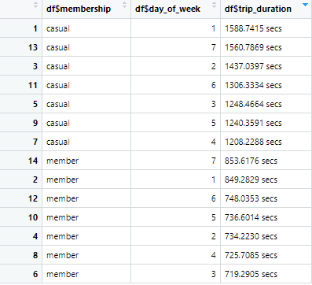
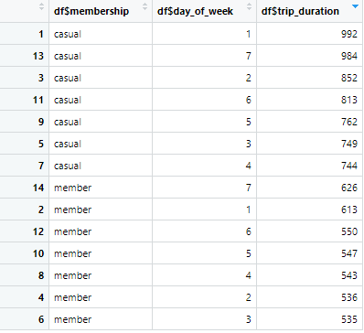
Aggregate Tables (Mean and Median)
Notes:
Sunady is 1, Saturday is 6

Slide 16
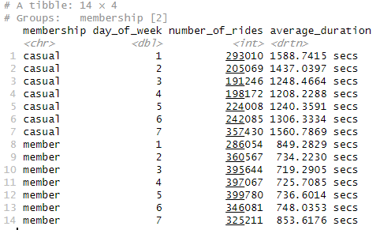
Total Daily Trips by Membership

Slide 17
Total Daily Trips by Membership (Percent Change)
Casual(Percent): Sun(0%) -> Mon(-30%) -> Tue(-7%) -> Wed(+4%) -> Thu(+13%) -> Fri(+8%) -> Sat(+48%)
Casual(Count): Sun(293010) -> Mon(205069) -> Tue(191246) -> Wed(198172) -> Thu(224008) -> Fri(242085) -> Sat(357430)
Member(Percent): Sun(0%) -> Mon(+26%) -> Tue(+10%) -> Wed(0%) -> Thu(+1%) -> Fri(-13%) -> Sat(-6%)
Member(Count): Sun(286054) -> Mon(360567) -> Tue(395644) -> Wed(397067) -> Thu(399780) -> Fri(346081) -> Sat(325211)

Slide 18
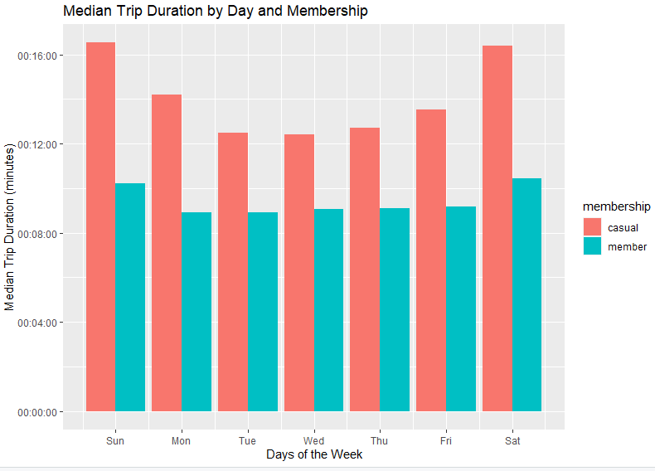

Slide 19
